Slide 1
Big Data Analytics using Spark
CSE255 / DSE230

Slide 2
What is “Big Data” ?
1GB?
1TB?
1PB?
….
We need a definition that does not change over time.
More data than can fit on a single work-station.
Communication dominates computation.

Slide 3
“Data Science” vs. “Computer science”
Computer science focuses on the algorithm
Requirements specify input to output relationship (find shortest path)
Algorithm should be correct and efficient
Input (data) can be anything that conforms to input format.
Data Science focuses on the data.
The goal is to understand/ model / control the physical process generating the data.
Algorithms are used by the data scientist to identify patterns in the data.
Data is assumed to conform to a statistical model.

Slide 4
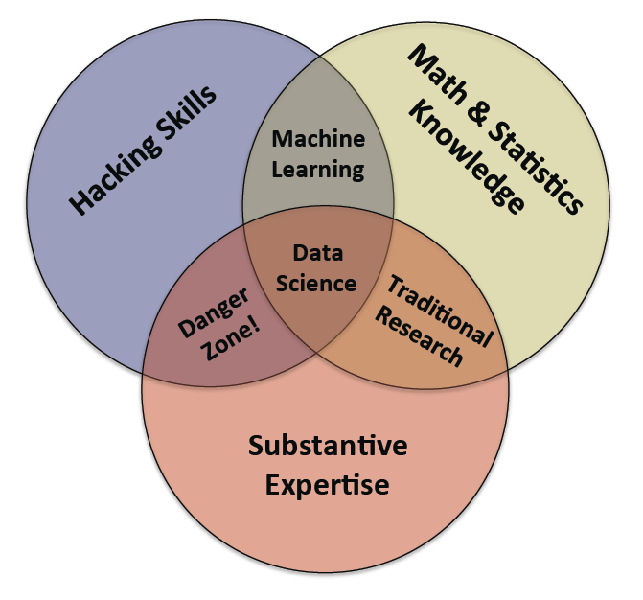
What is a data scientist?
From: Doing Data Science: Straight Talk from the Frontline
Rachel Schutt & Cathy O’Neil
& Communication skills

Slide 5
There are many good jobs in data science
Data Scientist: One of the ten top jobs in 2016 according to Forbes and glass-door.
There are currently 8446 data science openings in the US (LinkedIn).
7000 openings in India (naukuri.com),
Median base salary is around $116,000 per year (Glassdoor).

Slide 6

Halicioglu graduated with a bachelor’s degree in computer science in 1996

Slide 7
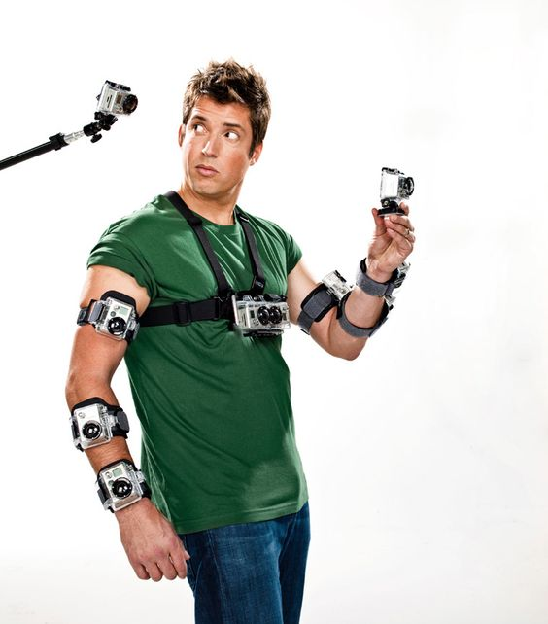
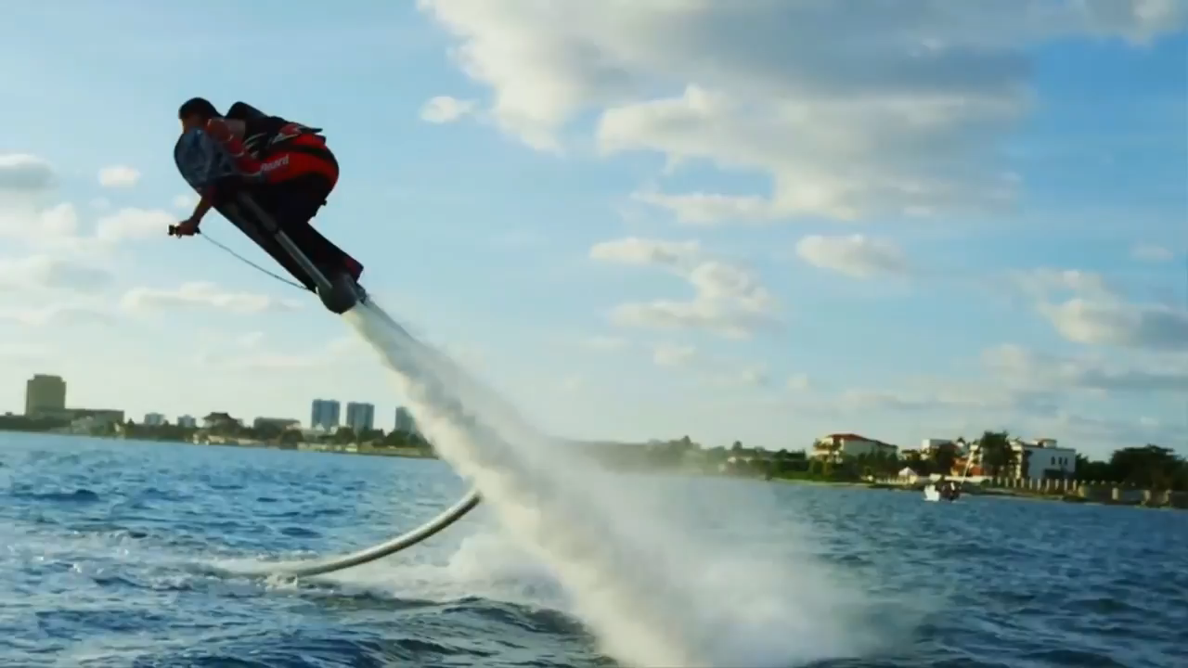
Nick Woodman, Founder of Go-Pro
Woodman graduated from UCSD in June 1997
with a B.A in visual arts and a minor in creative writing.

Slide 8
The output of a single goPro
GoPro Hero Black 5: $400.
120 FPS 1080p 1920X1080
= 250Mpixel/sec each pixel 3*8 bits = 6Gbit / sec
Max compressed output bitrate 60Mbit/sec
Compression by a factor of 100.
2:14 minutes = 1GB compressed.
Image processing requires uncompressed

Slide 9
Processing at the source
Suppose you wanted to use GoPro to monitor your front door.
The GoPro uses sophisticated lossy compression to reduce data by a factor of 100.
However, to perform analysis, your PC would have to uncompress the data and then process >40GB per minute.
You would need a beefy computer.
But most of the time there is very little change from frame to frame, so if change detector is implemented on the camera, there is, most of the time, nothing to communicate.

Slide 10
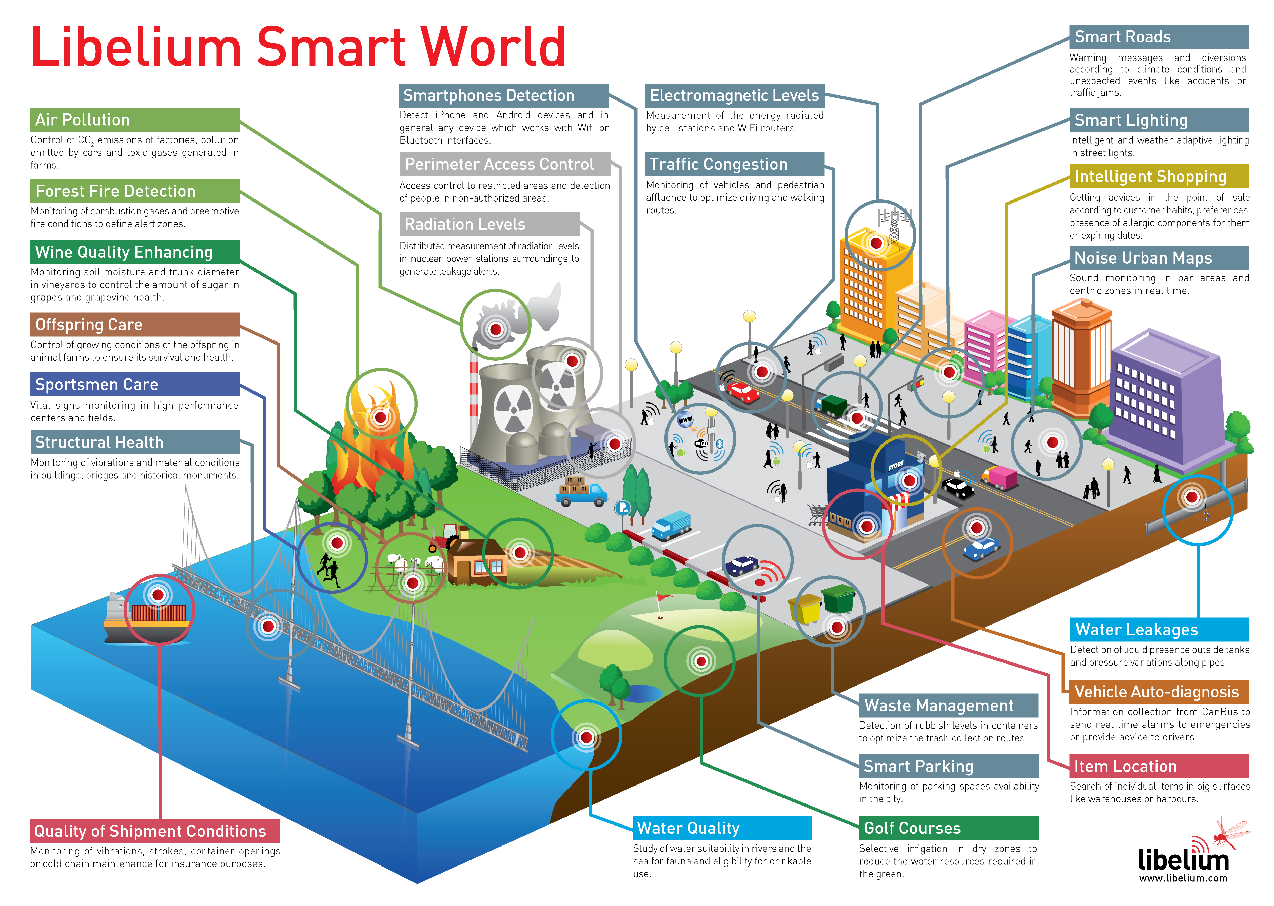
Scaling up: Sensor networks & Smart cities

Slide 11
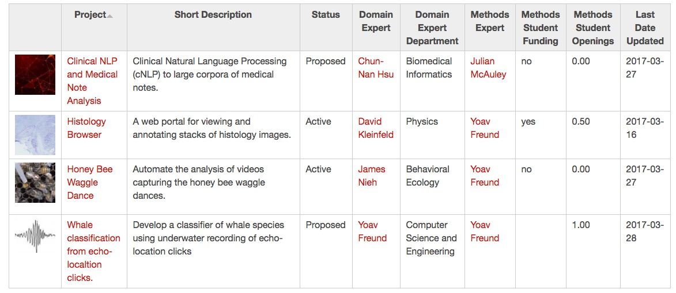
MatchPoint https://datascience.sdsc.edu/matchpoint

Slide 12
CSE255 / DSE230
A fun course
Not an easy course.
Weekly HW, from Friday to Friday expect to spend ~10 hours on each HW.
You are expected to figure out things on your own.
Consult documentation of python, spark etc.
Brush up on your linear algebra, eigen-vectors, eigen-values, eigen-decomposition.
See linear algebra material on web site.
Wikipedia
You are expected to participate in class and on Piazza.

Slide 13
What will you learn?
From: Doing Data Science: Straight Talk from the Frontline
Rachel Schutt & Cathy O’Neil
Python
Spark
Linear Algebra
PCA
Regression
Classification
Jupyter Notebooks
Visualization
Interpretation
Breakdown Problems
& Communication skills

Slide 14
Jupyter Notebooks
Pull them from the github repository.
They are your main resource:
Class Slides are derived from the notebooks
Code
Explanations
Pointers to additional resources
Exercises

Slide 15
Grading
HW: 50%
There will be 9 HW assignments, the one with the lowest grade will be dropped from the average.
Quiz: 10%
At the end of class on random days. Lowest grade dropped from average.
Breakdown Problems: 10%
Explained on class web page.
Final: 30%
Yet do decide whether in-class or take home.

Slide 16
More details on the web site
Go to
https://mas-dse.github.io/DSE230/

